Slide 1
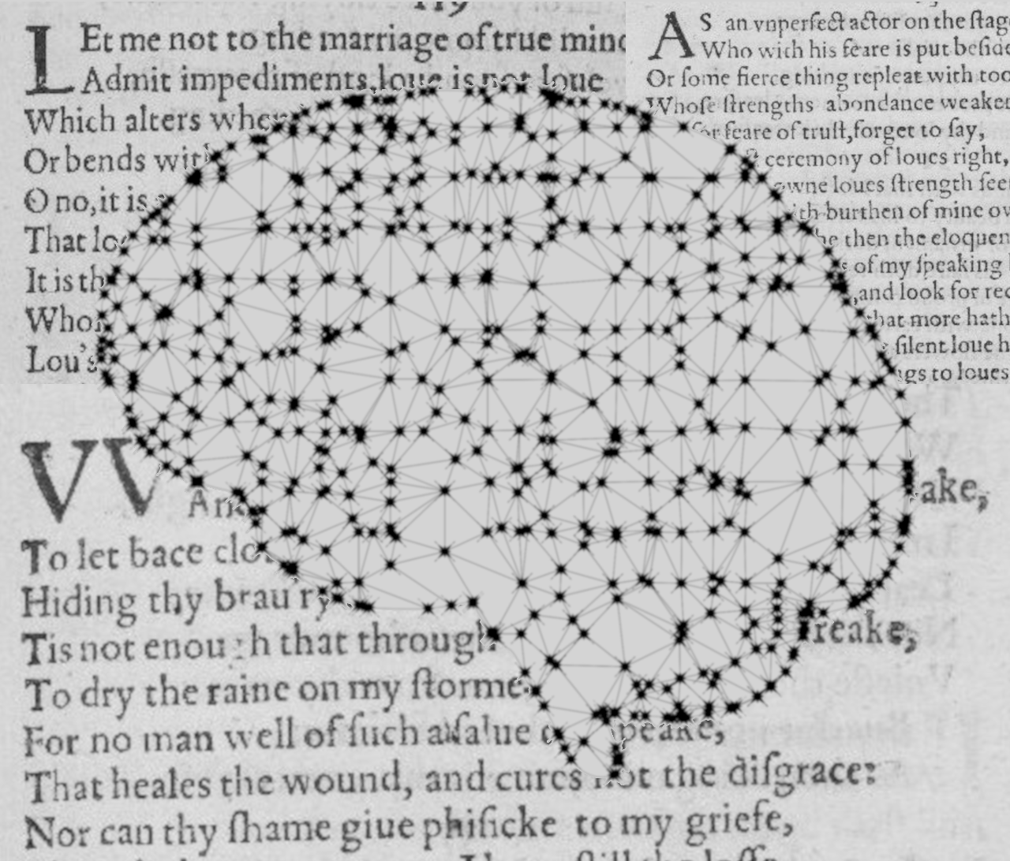
Author Classification in Poetry
Institut für Maschinelle Sprachverarbeitung
Katrin Schmidt & Carlotta Quensel
Team Lab NLP | SS2021 | 14-06-2021

Slide 2
Author classification
Goal
Stylometrics: what age, education, gender, social class has the author
Find specific values for one author
Author prediction: classification task with known classes
Which of my 5 authors has written this text
Our goal: find a method which works well with poetry
Style choices might reflect the medium more than the author
Choice of data is limited

Slide 3
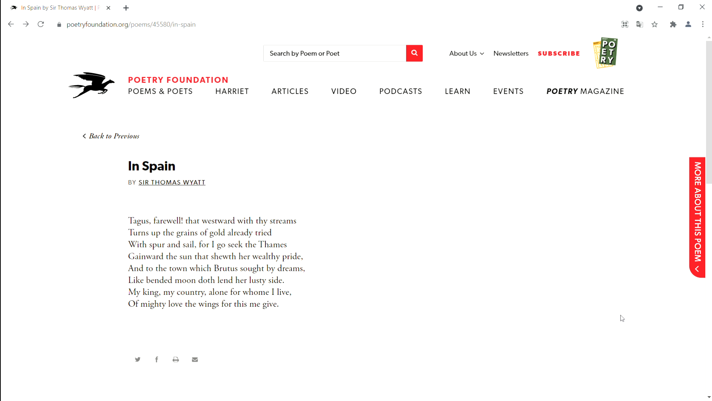
Author classification
Data
Data: Poetry Foundation

Slide 4
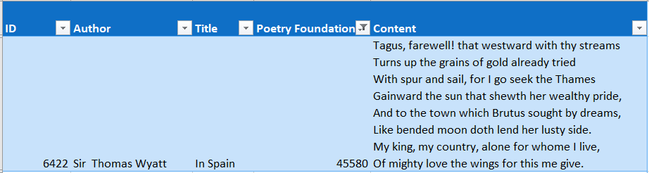
Author classification
Data
Data: Poetry Foundation

Slide 5
Outline
Task description
Goal
Data and preprocessing
Baseline model (Approach/Method/Architecture?)
Results
Next steps: advanced method

Slide 6
1. Task description
Goal
Develop a classifier to identify the author given a document
Program should be able to assign a document an author from its set
based on training data
authors have been already seen (no zero shot learning)
How does the composition of a poem represent the author?
Used words (word vectors)
Length (number of verses, stanzas)
Literary devices (rhyming, metre, anaphora)

Slide 7
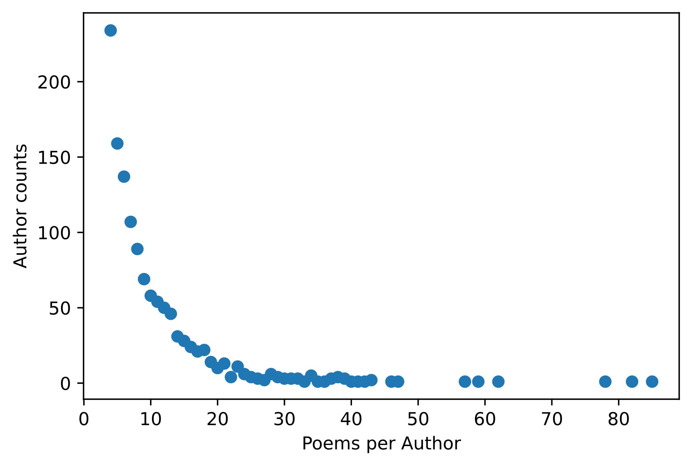
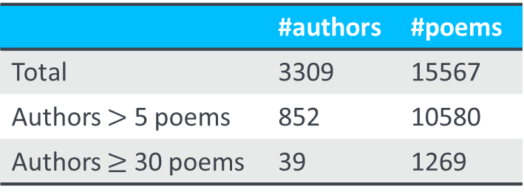
1. Task description
Data and preprocessing
Data sourced from the Poetry Foundation (founded in 2003), downloaded as finished dataset (csv file) from kaggle.com
Data statistics:
Why?
Most prolific authors → more datapoints per author
39 authors = 39 labels, lower computational power than with 800 labels
 | #authors | #poems
Total | 3309 | 15567
Authors $>$ 5 poems | 852 | 10580
Authors $≥$ 30 poems | 39 | 1269

Slide 8
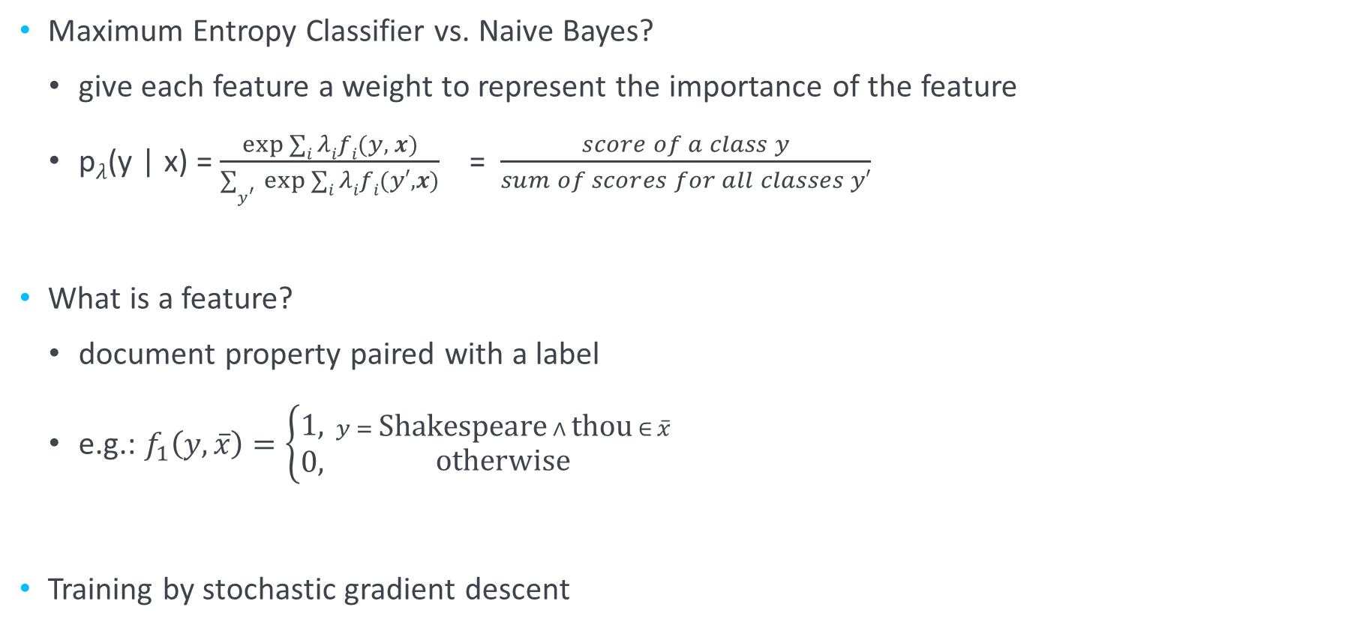
2. Baseline model
Maximum Entropy classification
Maximum Entropy Classifier vs. Naive Bayes?
give each feature a weight to represent the importance of the feature
p$λ$(y | x) = $\frac{\exp{∑i λifi(y, x)}}{∑y^{′ }\exp{∑i λifi(y′,x)}}$ = $\frac{score of a class y}{sum of scores for all classes y′}$
What is a feature?
document property paired with a label
e.g.: $f_{1}\left(y,\overline{x}\right)=\left\{\begin{aligned}1, \\ &0, \end{aligned}{y = \text{Shakespeare} ∧ \text{thou} ∈ \overline{x} \atop \text{otherwise}}\right.$
Training by stochastic gradient descent

Slide 9
2. Baseline model
Our implementation
Documents as 0/1 word vectors built from the vocabulary of the training data
Features have a label string and the index of a word as the document property
Learned from the training data as pointwise mutual information
Program:
Learn 50 features for each label in the training data
Assign a random weight to each feature
Calculate the classifier’s accuracy with these weights
Improve them through iterative optimization with stochastic gradient descent:
calculate the derivative of the function F (conditional log likelihood)
new_weight = old_weight - derivative
Classify by computing the p(label|doc) and choosing the label with the highest probability

Slide 10
3. Results

Slide 11
4. Next steps

Slide 12
Katrin Schmidt
Carlotta Quensel
katrin.schmidt@ims.uni-stuttgart.de
carlotta.quensel@ims.uni-stuttgart.de
source1
source2
source3

